Slide 1
IBM Coursera advanced data science capstone project
Hamza Jamshaid
Human Activity Recognition

Slide 2
Outlines
DATASET / USE CASE.
DATA EXPLORATION.
MODEL DEFINITION / TRAINING.
MODEL SELECTION.
DEEP LEARNING SOLUTION.
MODEL EVALUATION.

Slide 3
DATASET
The data set has been published by.
1 - Smartlab - Non-Linear Complex Systems Laboratory DITEN - Università degli Studi di Genova, Genoa (I-16145), Italy. 2 - CETpD - Technical Research Centre for Dependency Care and Autonomous Living. Universitat Politècnica de Catalunya (BarcelonaTech). Vilanova i la Geltrú (08800), Spain activityrecognition '@' smartlab.ws .
Contains
10299 Instances
561 Attributes
It’s a record of 6 differet types of activities( walking, walking_upstairs, walking_downstairs, sitting, standing, laying) labeled as 1,2,3,4,5 and 6 respectively.

Slide 4
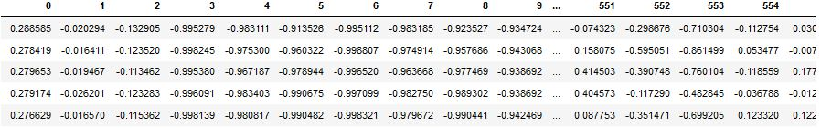
dataset - Attributes

Slide 5
Dataset information
The features selected for this database come from the accelerometer and gyroscope.
Subsequently, the body linear acceleration and angular velocity were derived in time to obtain Jerk signals (tBodyAccJerk-XYZ and tBodyGyroJerk-XYZ).
Also the magnitude of these three-dimensional signals were calculated using the Euclidean norm (tBodyAccMag, tGravityAccMag, tBodyAccJerkMag, tBodyGyroMag, tBodyGyroJerkMag).
Finally a Fast Fourier Transform (FFT) was applied to some of these signals producing fBodyAcc-XYZ, fBodyAccJerk-XYZ, fBodyGyro-XYZ, fBodyAccJerkMag, fBodyGyroMag, fBodyGyroJerkMag.

Slide 6





Use case
Create a Model that would record daily and weekly activity.
Classify that activity and help user learn about his routine.
This could help people with health issues and people who don’t get much exercise.
Also it would be a reliable and easy way to keep track and monitor one own routine.

Slide 7
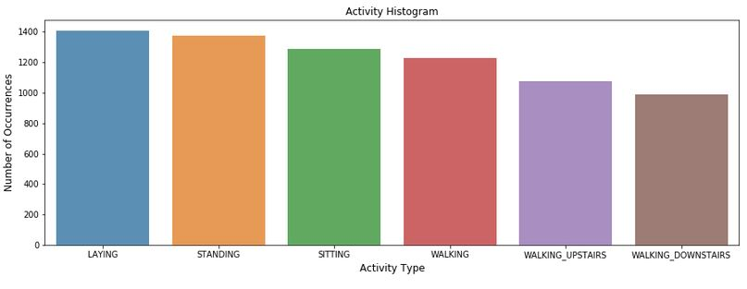
Data exploration

Slide 8
Model definition – using scikit
Train data
Standard Scaling
PCA n-components 220
Train Model
Model Evaluation

Slide 9


Model training
We use the X_train and y-train files to train the data
We apply feature normalization and PCA to the data

Slide 10
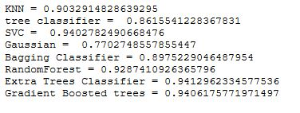
Model Results

Slide 11
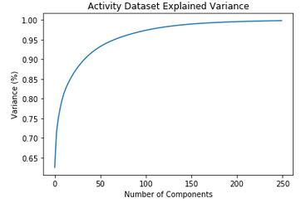
Enhancing model with PCA
In order to improve our results we apply normalization and PCA.
According to the PCA plot after 200 features the variance is more than 95%, hence we select 250 components for our PCA function.

Slide 12
Improvement
Older SVC result
Newer SVC result.
The accuracy has increased almost 1%.

Slide 13
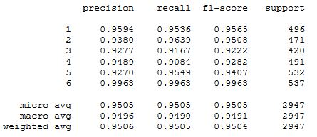
Precision, recall and f1 score

Slide 14
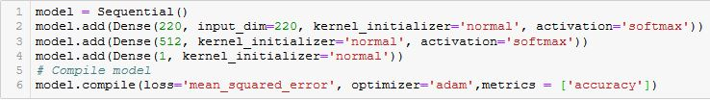
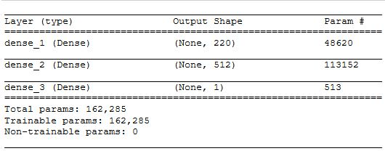
Model definition – deep learning
We have used a sequential keras model for this problem.
The model has single hidden layer and one input and output layer.

Slide 15

Results of deep learning
The model is almost 95% accurate.
This is the same as our support vector machine algorithm.

Slide 16
Conclusion
We have successfully achieved 95%, using both conventional and deep learning algorithms.
For deployment purposes we would deploy our model as a Smart Phone Application.
We are looking forward to enhance our model by collecting user data.

